Slide 1
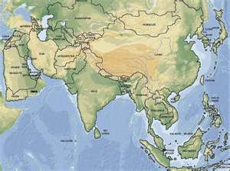
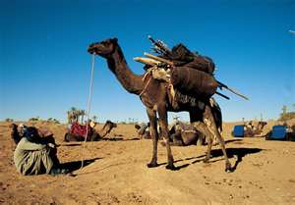
The quiz 1 - geography
1)What continent is the largest of all?
2) What is the largest desert in the world?

Slide 2
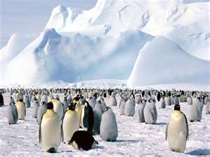
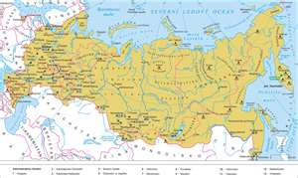
3) Where is the coldest place in the world?
4) What is the largest country in the world?

Slide 3
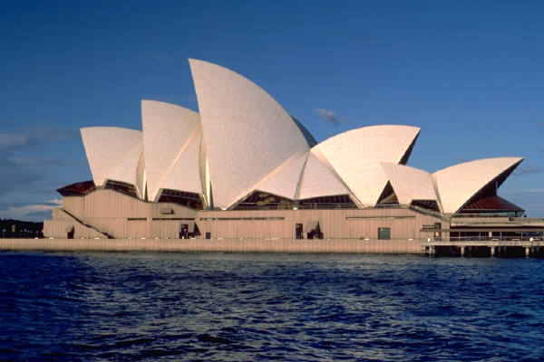
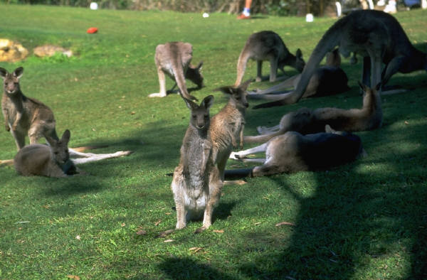
5) What mountain is the highest in the world?
6) What is the smallest continent in the world?

Slide 4
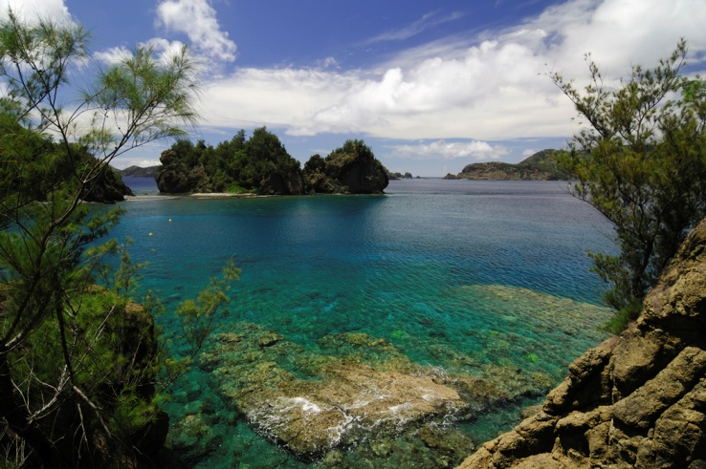
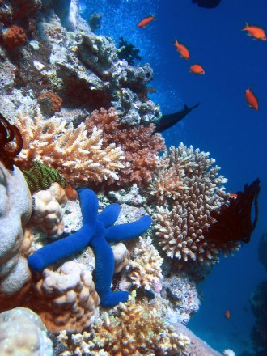
7) What is the largest ocean in the world?
8) Where is the largest coral reef in the world?

Slide 5
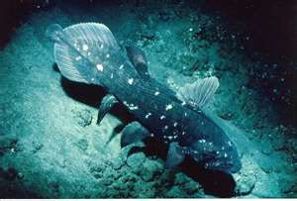
9) What is the second largest coutry in the world?
10) Where is the deepest place in the world?

Slide 6
The quiz 2 – science
What is the largest animal in the world?
What is the tallest animal in the world?
What animal lives for the shortest time?
What is the fastest animal in the world?

Slide 7
